Slide 1

Consumer Empowerment Program
Power of Prosumer

Slide 2
The World is Changing From
CONSUMER
PROSUMER

Slide 3

CONSUMER
PROSUMER
Spends Money To
Purchase Products
No Extra Benefit
No Savings
Spends Money To
Purchase Products
Saves Money &
Earns Money

Slide 4
EXAMPLE OF A PROSUMER
Using
Saving,
Referring,
Earning.
PAYTM,
PHONE PAY,
GOOGLE PAY,
SWIGGY,
ZOMATO.

Slide 5





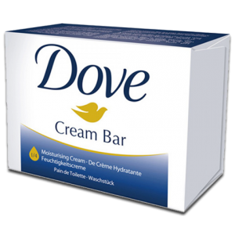
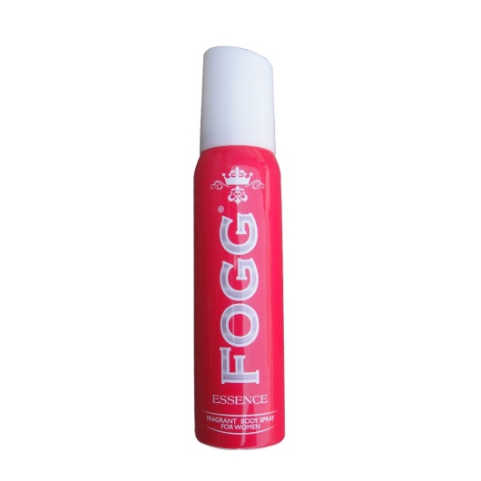



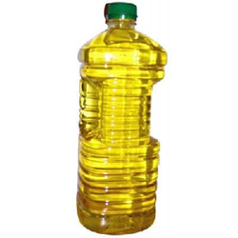
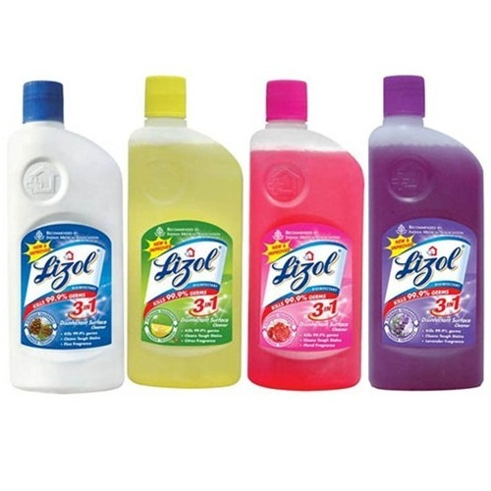


DO YOU USE THESE PRODUCTS....?
Toothpaste
Tooth Brush
Tea / Coffee
Soap / Hand Wash
Face Wash
Fairness Cream
Shampoo / Deo
Hair Oil
Make Up Products
Cloth Cleaner
Dish Cleaner
Home Cleaner
Cooking Oil

Slide 6
WHILE SHOPPING DO YOU GET ?
High Quality Products
Life Time Discount
Life Time Free Products
Life Time Cash Back
Gift Hamper On Regular Purchase
Referral Earnings

Slide 7

BUT ONE
COMPANY
GIVES YOU
ALL THESE
B E N E F I T S
Since 2004

Slide 8
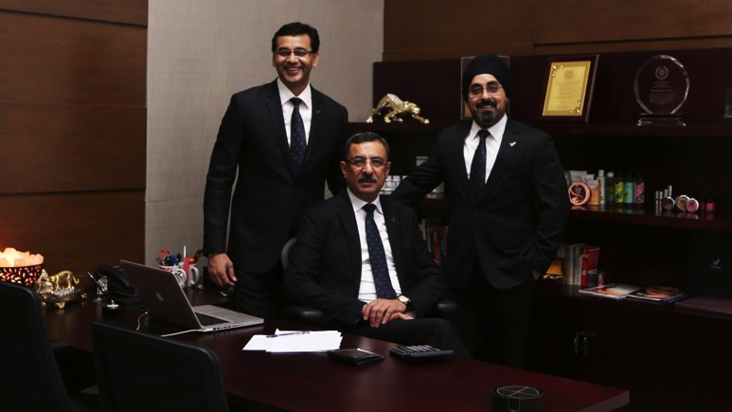
VESTIGE – The Visionary Management
Mr. Gautam Bali, Mr. Deepak Sood, Mr. Kanwarbir Singh

Slide 9

COMPANY BACKGROUND
Head Office: New Delhi
Started with just 10 Products
Now Having 250+ Products
5000+ Products Through Vestige Best Deals
3000 Service Branches in India
63rd Position In World Ranking
Now In Nepal, UAE, Bahrain & Bangladesh
1800+ Crore Turnover
Targeting 20 Countries by 2020
1.80 Crore Prosumers
Prosumers Earning Lakhs Monthly
4500+ Car Prosumers
180+ Luxury Car Prosumers
15000+ Foreign Trip Prosumers

Slide 10
BENEFIT TO VESTIGE PROSUMERS
10% to 20% Discount
10% Extra Gift Product
Purchase Between 2nd to 17th of Any Month
Monthly 3% to 12% Cash Back on Purchase Price
(5% to 20% On Business Volume As Per Company Plan)
Rs. 2500 worth Free Products
On Monthly Purchase Min. Rs. 3000/-
For Consecutive Four Months
Min 100 PV As Per Company Plan
Purchase Should Be Between 2th To 12th
Purchase Should Be In Single Invoice

Slide 11
Example on Min. Shopping of Rs. 3500
1) 10% to 20% Discount – You Save = Rs. 500
So You Pay Rs. 3000 for Rs. 3500 Products
2) 10% Free Products on Rs. 3000 = Rs. 300
3) 3% to 12% Cash Back = Rs. 90 to Rs. 360
Lets Take 5% = Rs. 150
4) Rs. 7500 Worth Products Free Yearly ( For Loyal Customers )
Monthly It Comes To → Rs. 7500 / 12 = Rs. 625
Lets Total It Rs. 500 + 300 + 150 + 625 =
Rs. 1575

Slide 12
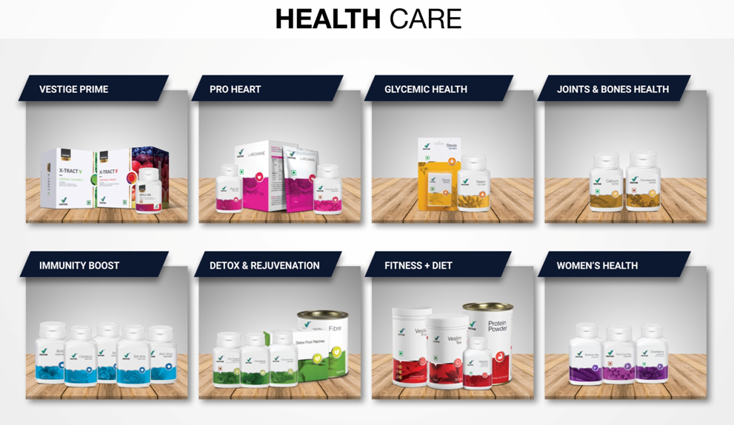
VESTIGE PRODUCT RANGE

Slide 13
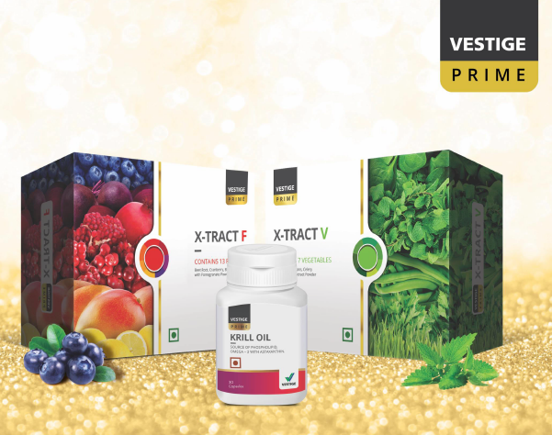

Slide 14
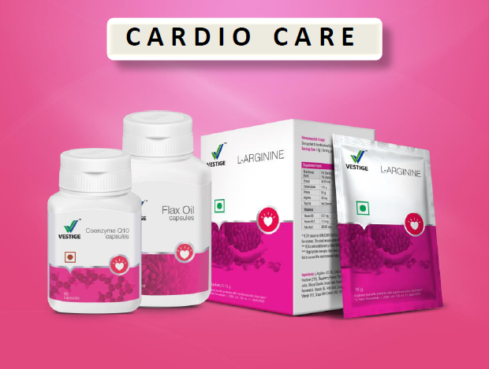

Slide 15
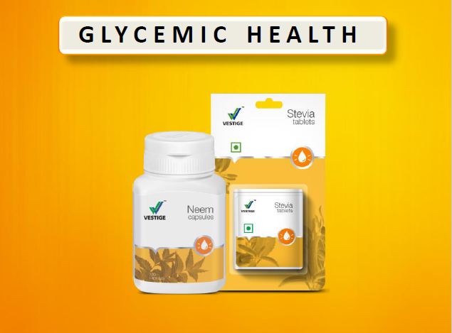

Slide 16
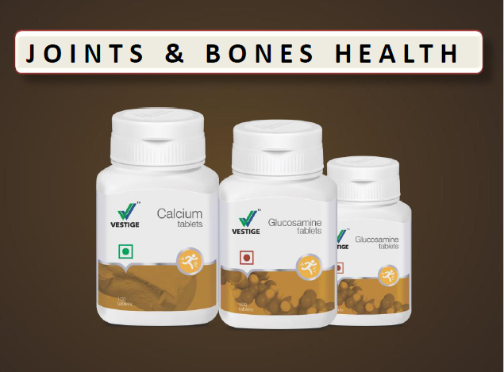

Slide 17
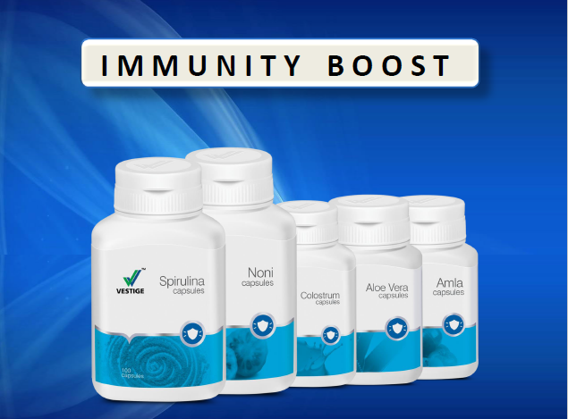

Slide 18
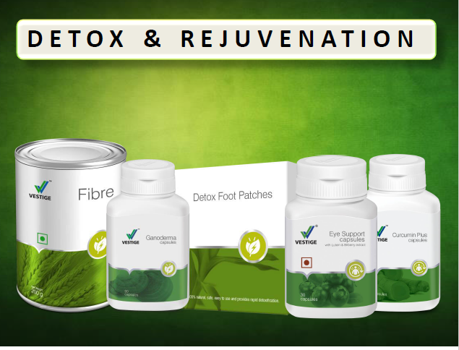

Slide 19
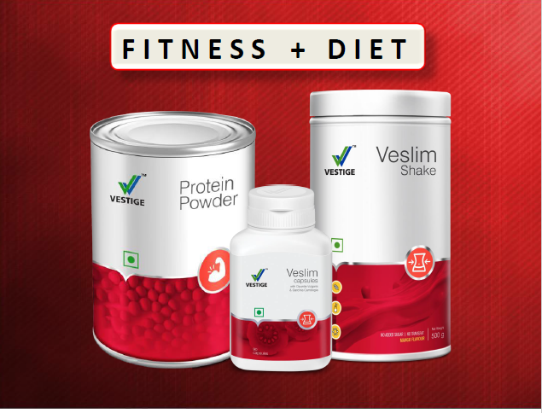

Slide 20
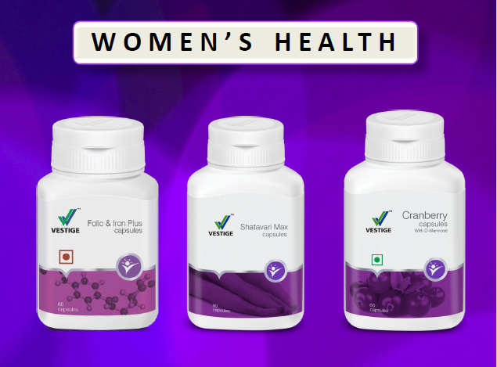

Slide 21
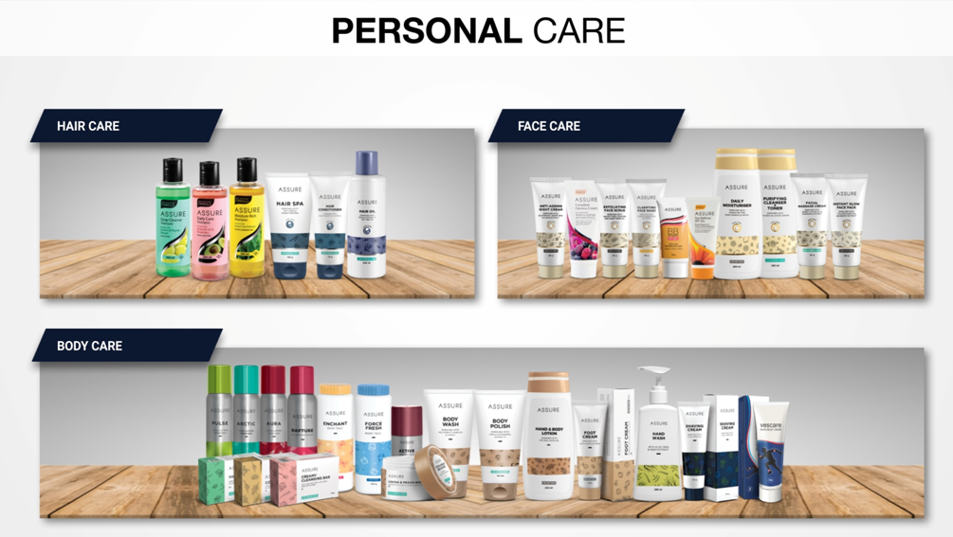
VESTIGE PRODUCT RANGE

Slide 22
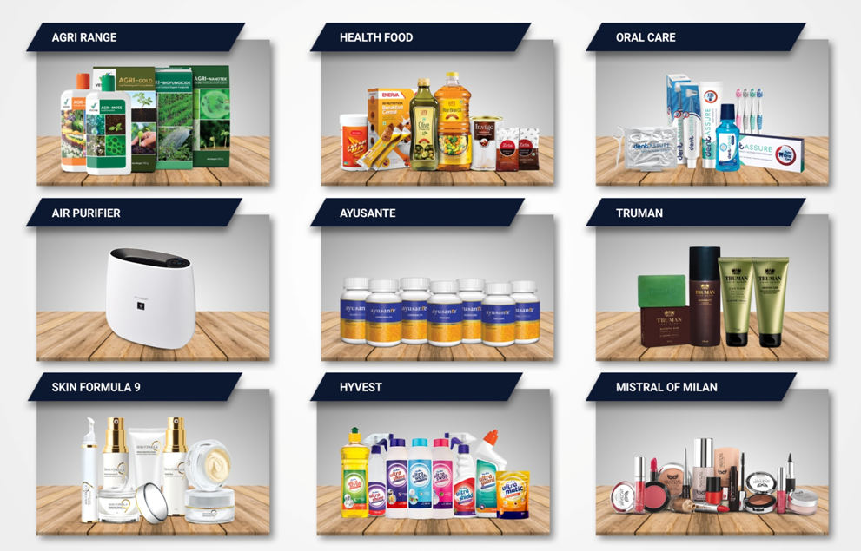
VESTIGE PRODUCT RANGE

Slide 23
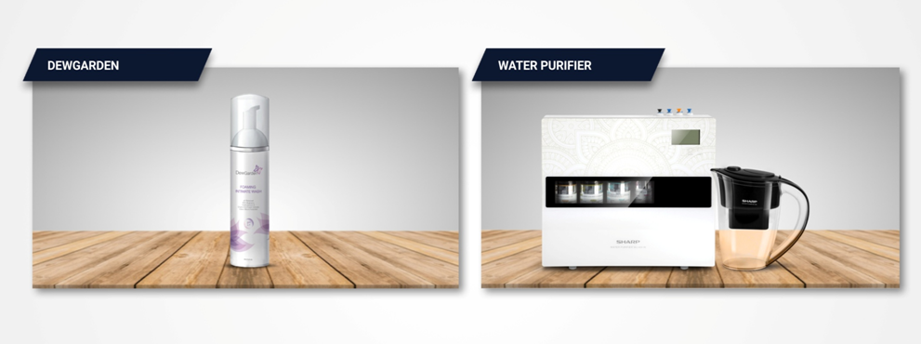
VESTIGE PRODUCT RANGE
UPCOMING MANY MORE PRODUCTS

Slide 24

For More Information Kindly Refer Product Catalogue

Slide 25



VESTIGE BEST DEAL PRODUCTS
Offers & Free Products on Other Products For Daily Needs

Slide 26
HOW TO BECOME A VESTIGE PROSUMER
Fill Registration Form - Online or Offline
PROOF FOR KYC (ADHAAR CARD / VOTER CARD / DRIVING LICENCE ETC.)
BANK DETAILS (BANK PASS BOOK OR CANCELLED CHEQUE)
PAN CARD
FIRST PURCHASE 30 PV (APPROX RS. 1000 VESTIGE PRODUCTS)
OR
FIRST PURCHASE 100 PV (MIN. RS. 3000 VESTIGE PRODUCTS)
WILL BECOUNTED AS 1ST MONTH OF CONSISTENCY OFFER
NO MEMBERSHIP FEES
NO RENEWAL FEES
LIFE TIME FREE MEMBERSHIP

Slide 27
VESTIGE GIVES EARNING OPPORTUNITY
YOU CAN EARN UNLIMITED
BY REFERRING PEOPLE
(As Per Vestige Opportunity Plan)
Kindly Attend Our
Business Opportunity Presentation

